Slide 1
Introduction to Java for C++ Programmers
SQLite Installation for Windows and Introduction
By: Mahboob Ali

Slide 2
Installation
www.sqlite.org

Slide 3
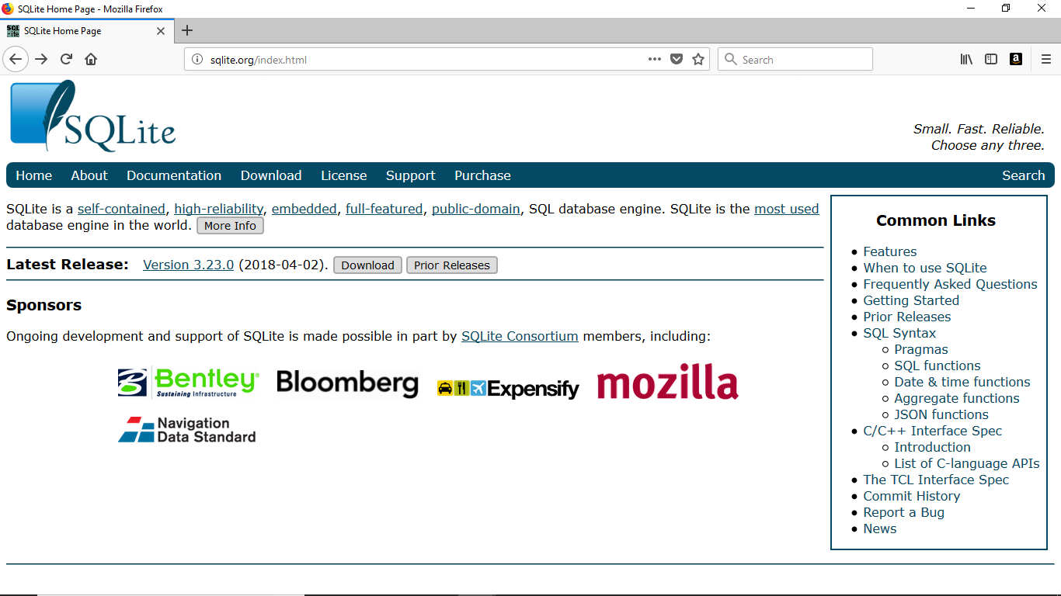
Click Download

Slide 4
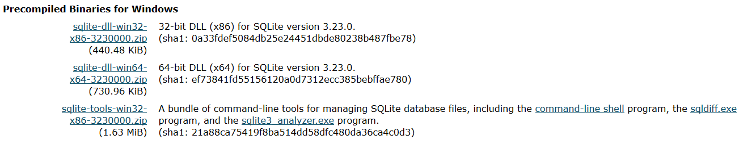
Go to the section for Precompiled Binaries for Windows,
Click to Download

Slide 5
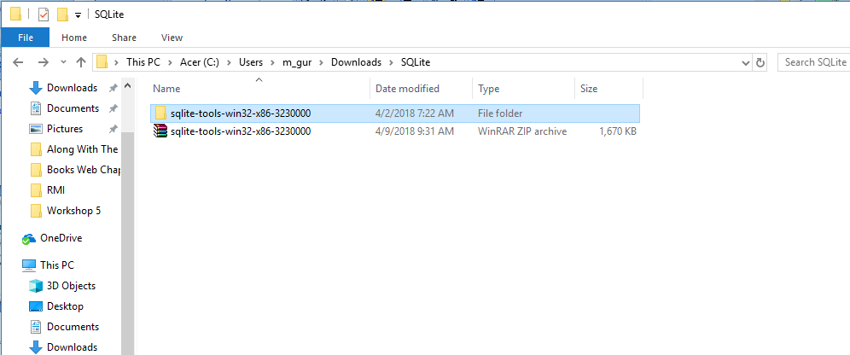
Unzip the file you just downloaded.
Cut the unzipped folder and paste into your user folder.
Unzipped
Downloaded File

Slide 6
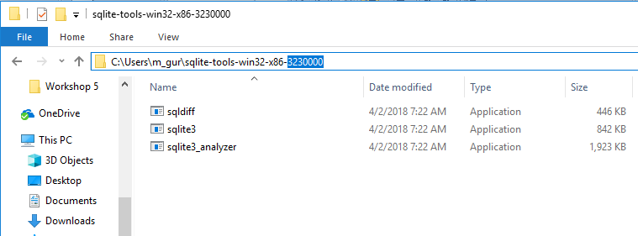
Copy the Path

Slide 7
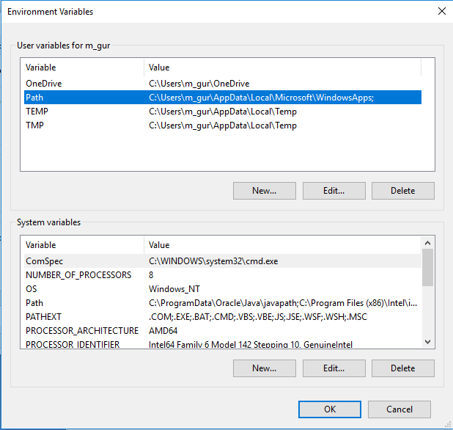
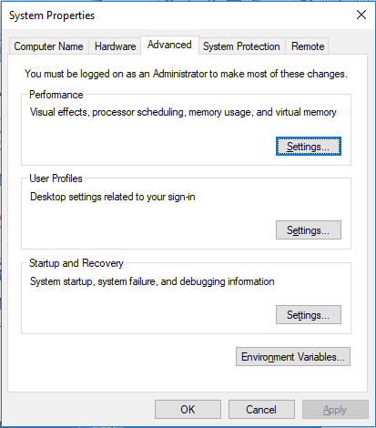
Open Environment Variable on windows
Select
Then
Click
Click Here

Slide 8
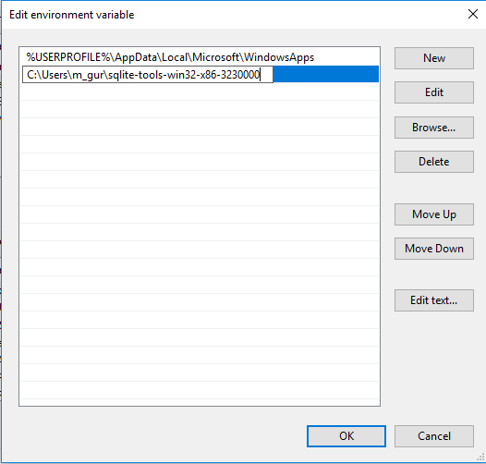
Click Here
Paste Here

Slide 9
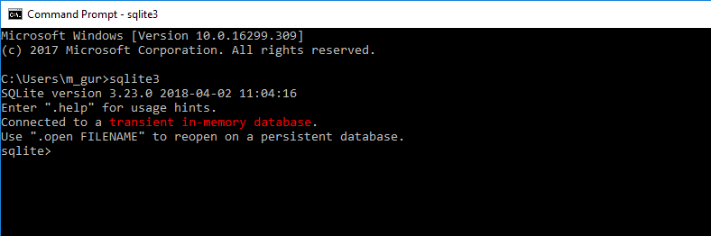
Installation check
Open command prompt.
Write .quit command to exit the SQLite.

Slide 10
SQLite 3
For more commands on SQLite3 you can use the official link for SQLite, https://www.sqlite.org/cli.html

Slide 11
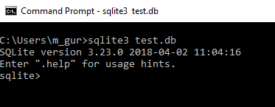
Test Database
Turn on the headers of the tables
Create table Contacts
Insert data into table Contacts

Slide 12


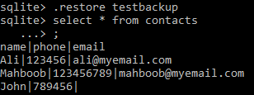
Select command on table
Backup command
UPDATE command
Restore command

Slide 13
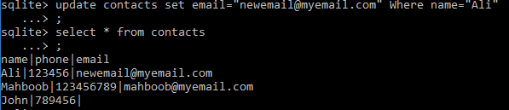
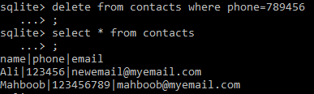

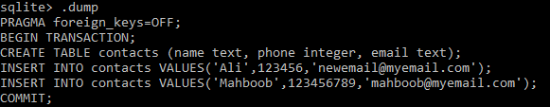
WHERE clause update
Delete and WHERE clause commands
Checking tables in the database
Checking the Schema command

